Slide 1
The Dynamics of GDP Growth and Socioeconomic Indicators
A Global Outlook
By,
Ashlin Shinu, George
UNC Chapel Hill BootCamp.

Slide 2
Data Overview
Data Sources:
Methodologies:
International Monetary Fund,https://www.imf.org/en/Home .
Our world Data, https://ourworldindata.org/
Javascript: Plotly, or Chart.js, SQL.
Data Ethics:
To maintain transparency in the data analysis process, I have diligently disclosed the origins of our data sources, outlined the methodology employed throughout the analysis, and explicitly documented any underlying assumptions guiding our analytical decisions.

Slide 3
Objectives
What were the notable changes in global GDP per capita trends over the past decade?
Global Trends in GDP Per Capita.
What are the top and bottom 5 countries with the GDP per capita over past years?
GDP Per Capita Analysis.
(Top 5 and Bottom 5 countries)
When did economy reached its highest or lowest level of economic activity and performance.?
Peak and Trough Years.
What are the impacts of high GDP in countries on poverty rates, unemployment rates, and literacy levels?
Poverty,Literacy,Unemployment rates.
*(top 5 countries)
How does an increase in GDP impact the Human Development Index (HDI)?
Human Development Index (HDI) .

Slide 4

Indicators of Economic Growth
GDP is the most widely used indicator to measure the economic growth of a country.
One of the primary signs of economic growth is an increase in employment rates.
A growing GDP indicates a healthy economy
High poverty levels can impede economic growth by limiting the development of human capital.
Other indicators: Poverty rate, Unemployment rate, literacy rate
Literacy equips people with essential skills and knowledge for effective work.

Slide 5
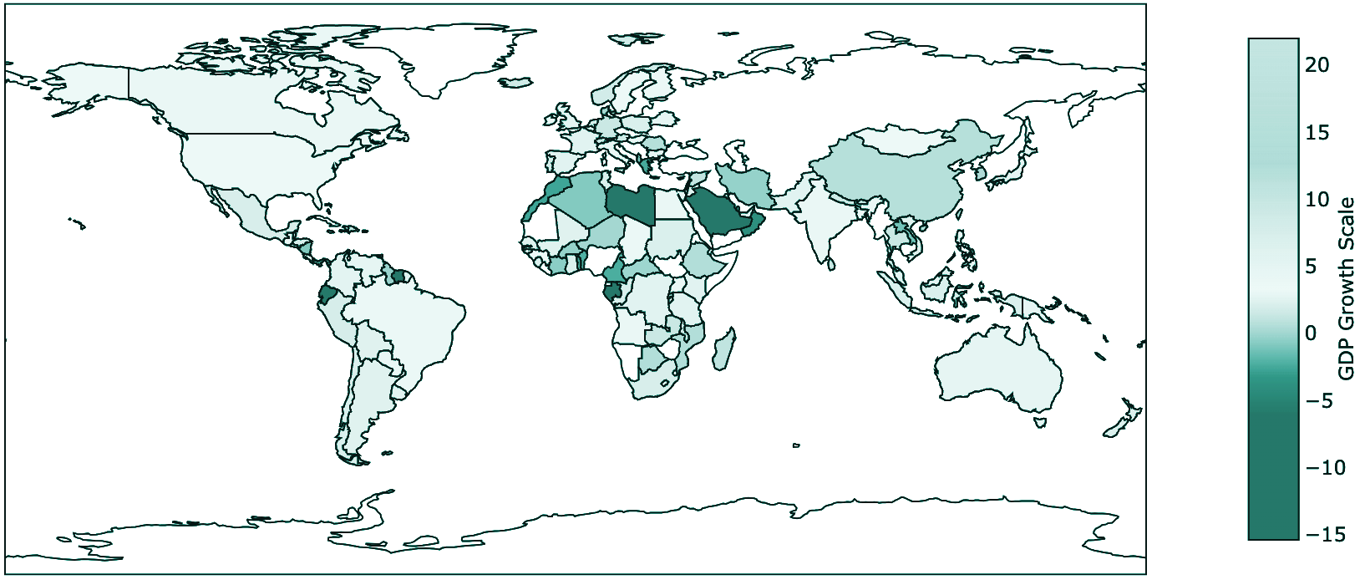
Global Trends in GDP Per Capita
Libya bounced back
Libya experienced a severe -50% GDP decline in 2011 due to the civil war but saw a remarkable recovery in 2012 with an impressive 89% growth rate.
Guyana’s Record
Guyana achieved a remarkable 62% annual growth rate while other countries faced economic declines.
United States of America
The United States typically saw its annual GDP per capita grow by 2% to 5%, except for a 2.6% drop in 1995 and a 2.8% fall in 2020.

Slide 6
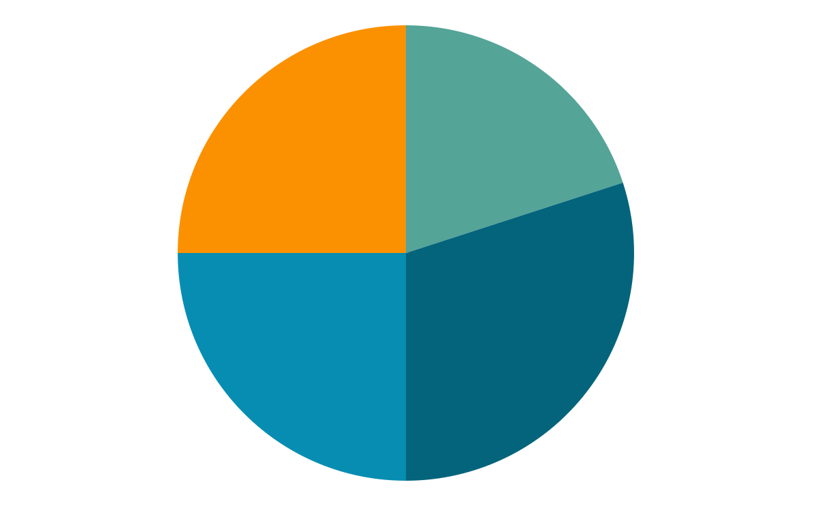
GDP Per Capita Analysis
(Top 5 and Bottom 5 countries)
Stability
Minimal contributors.
Since 1995, the USA, China, Japan, Germany, and the UK have consistently been among the top 5 GDP countries.
Tuvalu and Nauru are sharing the last two positions in terms of GDP.
40 million(USD)
20 trillion(USD)
An Island in pacific ocean called Tuvalu ranking among the countries with the lowest GDP of 40 million USD.
The United States has held the top spot in GDP for the past 15 years, with China consistently ranking second in recent years.

Slide 7
Peak and Trough Years in Global GDP Per Capita
Peak Year
“The Great Recession”
2004 was a pinnacle year, marked by strong global economic performance.
The Great Recession of 2009 was primarily caused by a collapse in the housing market, leading to a severe global financial crisis.
Economic Boom
"Pandemic Collapse"
From 2004 to 2007, there was a big increase in the world's economy, with many countries growing quickly.
In 2020 COVID-19 pandemic, the world faced a deadly economic crisis due to the impact of the

Slide 8
Poverty Rates in Top 5 GDP Countries(by 2020)
A
1.0%
United States of America:For decades, this nation has consistently maintained a relatively low poverty rate in proportion to its GDP growth.
B
0.1%
China:In China, the poverty rate dropped significantly from 48% in 1996 to just 0.1% in recent.
C
0.3%
Germany:A stable economy has led to consistently low poverty levels over the years in Germany.
D
0%
United kingdom:Despite a GDP fall in 2009, this country managed to maintain low poverty levels consistently.

Slide 9
Unemployment Rates and GDP Per Capita
USA
China
Germany
United Kingdom
The unemployment rate has varied, with a low of 3.6%, a peak of 9.6% during the 2010 recession
The unemployment rate in China has exhibited fluctuations within the range of 2.37% to 5.00% since 1995.
Germany's unemployment rate spiked at 10.73% in 2009 but then stayed low and decreased.
The unemployment rate reached its highest point of 10.6% in 1997 and 3.74% in 2001

Slide 10
Human Development Index (HDI)
of Top 5 Countries
HDI
The HDI Spectrum
The Human Development Index (HDI) ranks countries from 0 to 1 based on life expectancy, education, and income, with higher scores indicating better development.
The HDI rankings reveal that the US, UK, and Germany have consistently maintained high human development for decades, while China has shown significant progress in its HDI score, climbing steadily from 1995 to 2020.
A
B
C
D

Slide 11
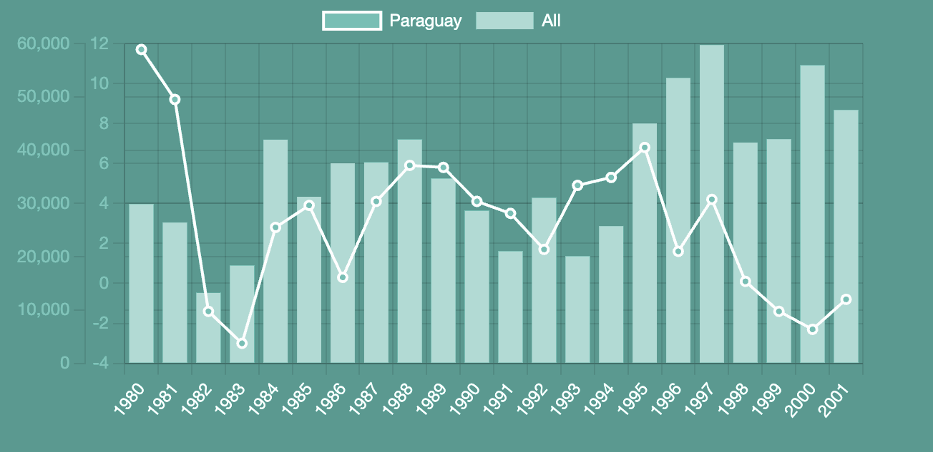
Literacy Rates and Their Impact
"Ukraine's Literacy Triumph"
Ukraine impressively holds the top position globally with a complete 100% literacy rate.
"A Decade of 99.99% Literacy"
Uzbekistan has consistently maintained a remarkable literacy rate of 99.99% from 2013 to 2022, showcasing its commitment to education and widespread knowledge among its population.

Slide 12
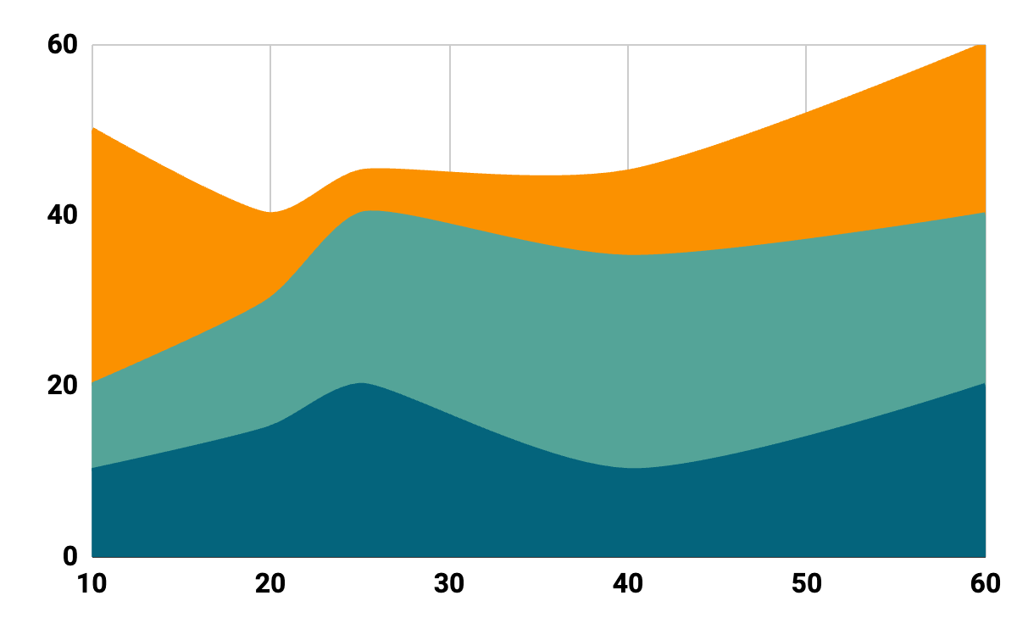
Interesting Insights and Conclusion
"Economic Crisis: Pandemic"
The COVID-19 recession will be the deepest since 1995, and more than twice as deep as the recession associated with the 2007-09 global financial crisis.
"China's Surge"
China, one of the most populous countries, has successfully grown its economy, reduced poverty, and increased employment despite its large population.

Slide 13
Thank You

Slide 14
Dashboard clips

Slide 15
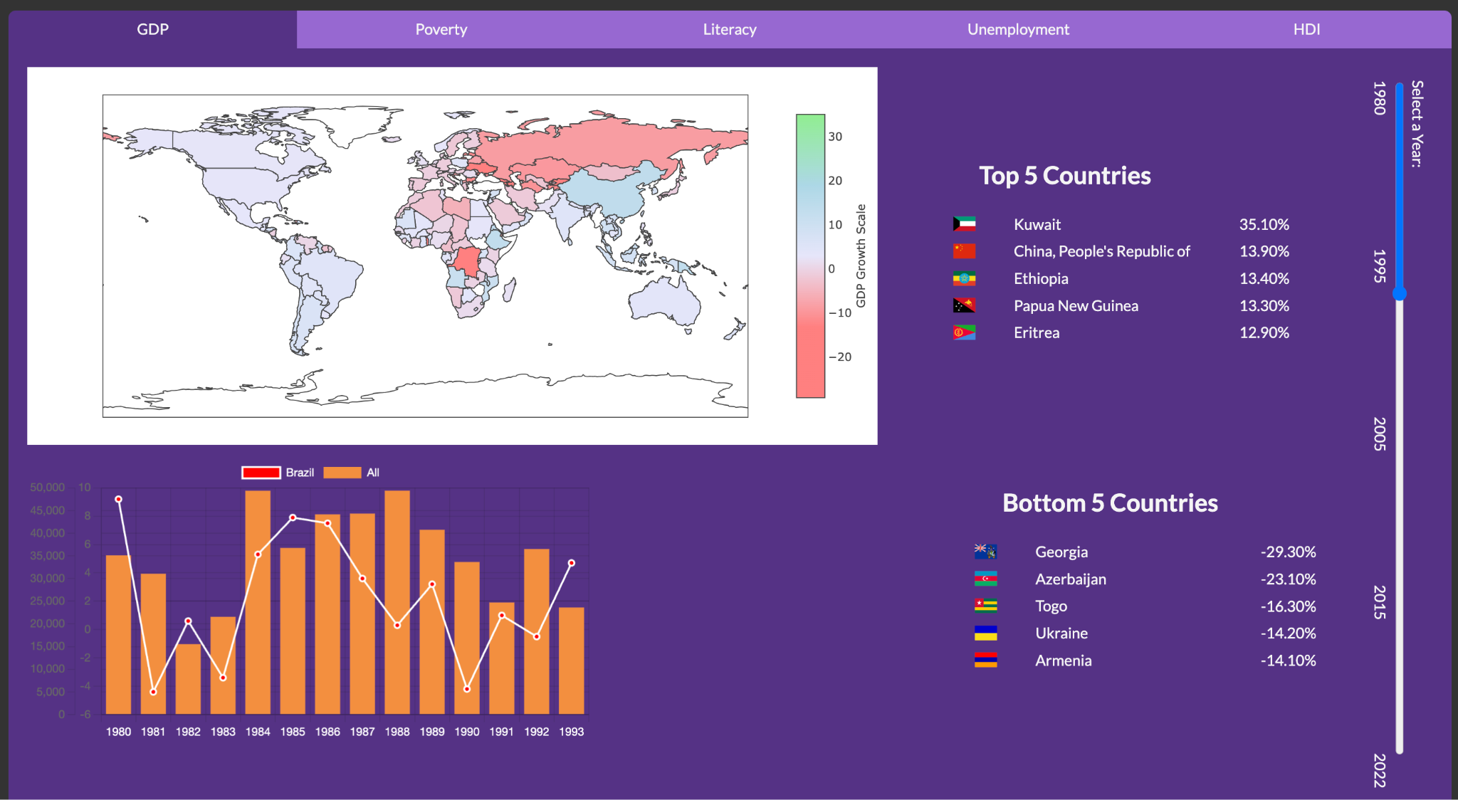

Slide 16
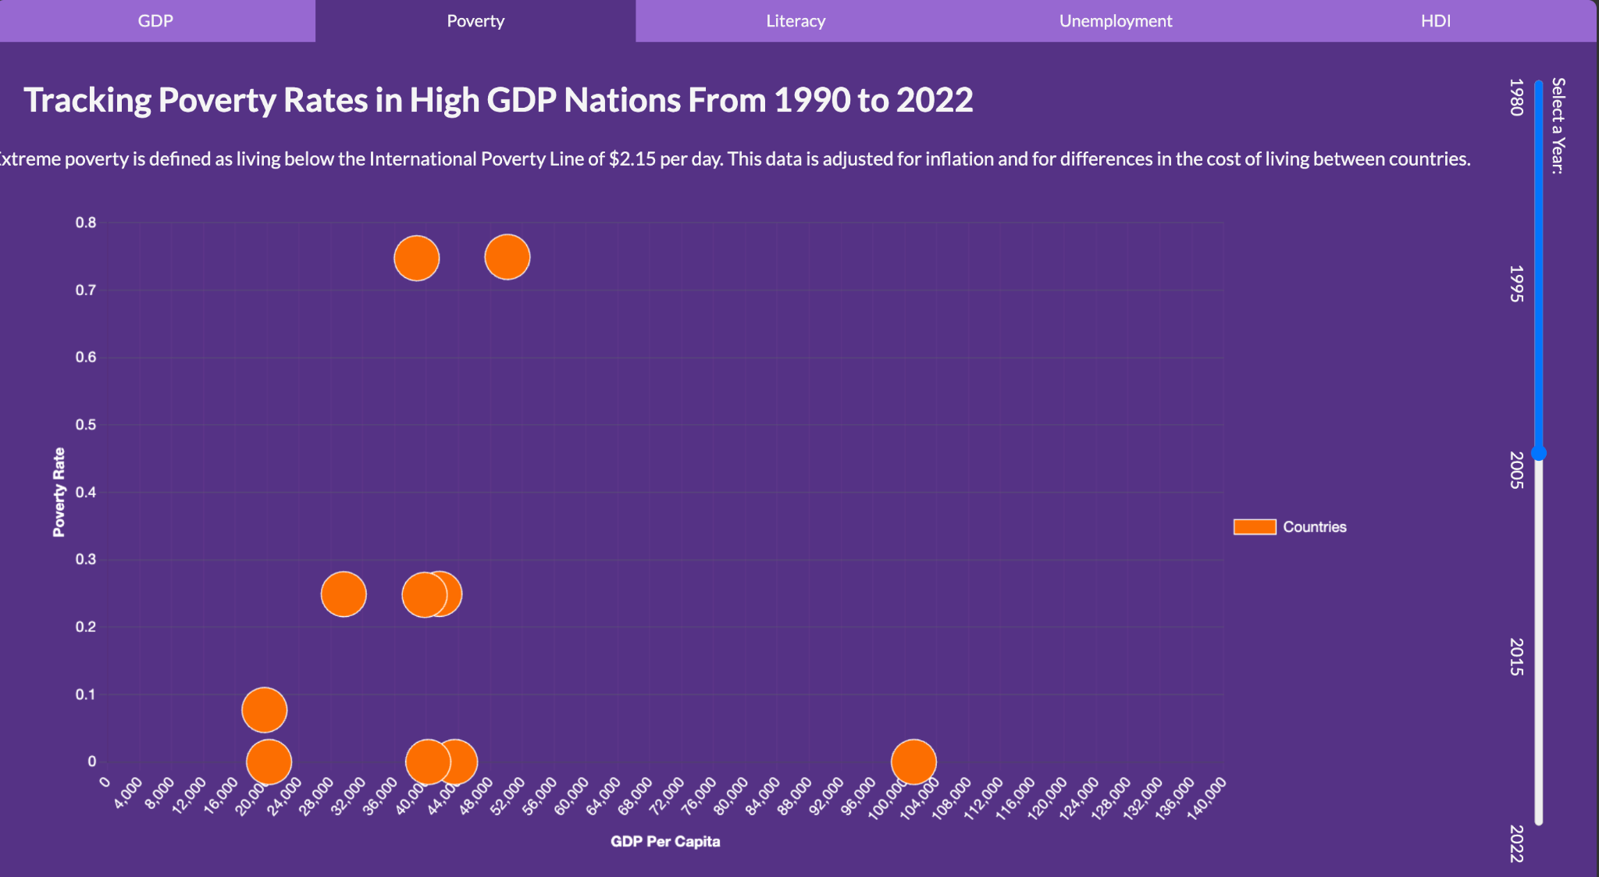

Slide 17
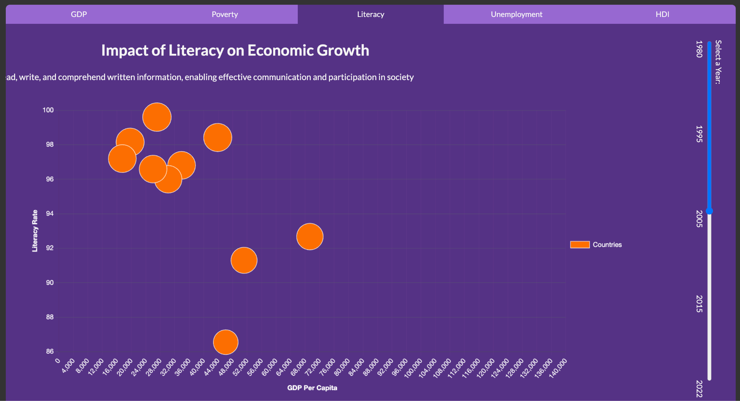

Slide 18
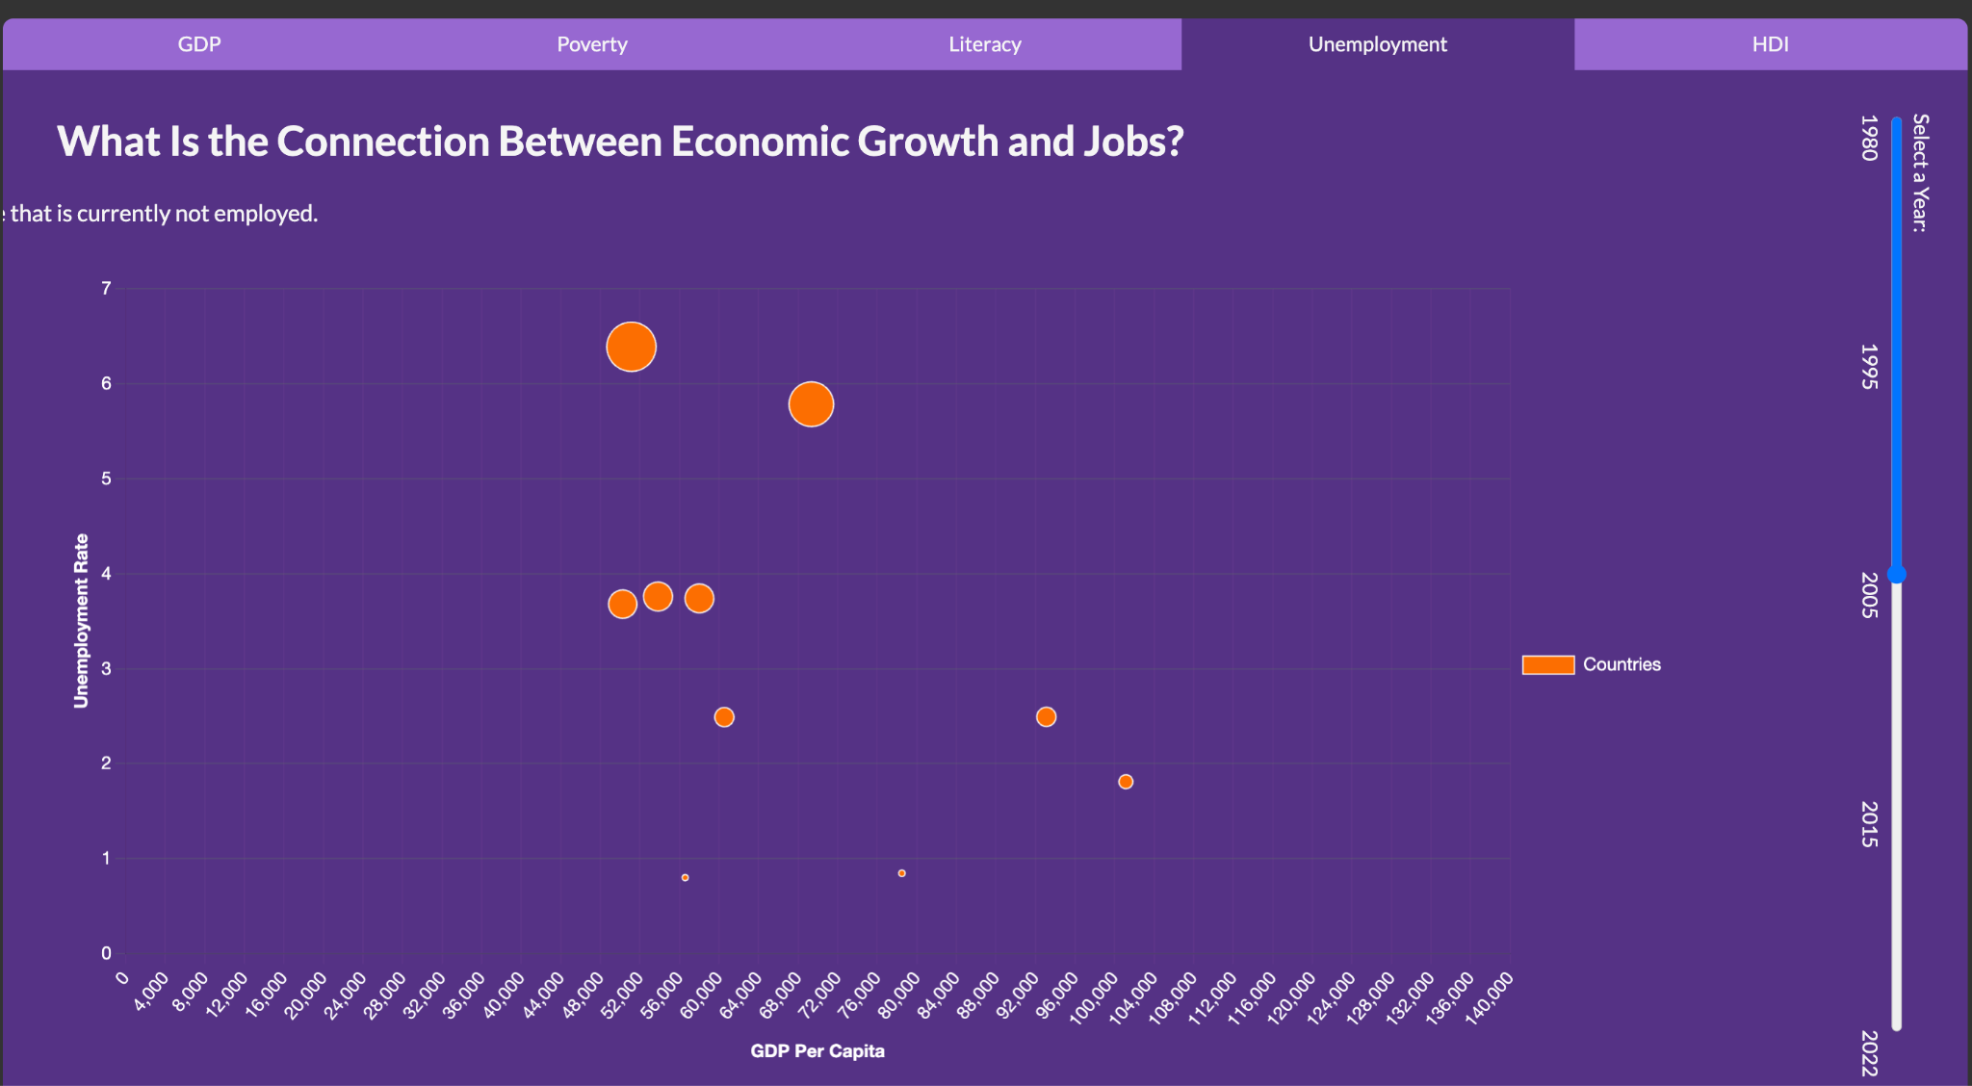

Slide 19
